Slide 1
Layers of a Service-Oriented Architecture

Slide 2
Outline
Objectives
On completing this module, you will be able to:
Understand the concept of atomic (micro)services and composite (micro)services
Understand sample layers in a service-oriented architecture (SOA)
Understand where microservices reside within an SOA layered architecture.
Understand the benefits of a layered SOA for developing enterprise solutions
Topics
Services, Microservices
Atomic and composite microservices
SOA Layers

Slide 3
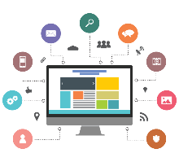

Definition of a Service in the Software World
A service may be defined as:
A unit that provides one or many functionalities needed to support business requirements and can be used by other applications or services over the network via a standard interface that is independent of programming languages and platforms
Input
e.g. search for a book
Service
Consumer
Interface
Service
Provider
Interface
F1
F2
e.g. order a book
Application 2
Output
Application 1
Service Consumer
(consumer)
Service Provider
(server)
The Service Provider Interface and the Service Consumer Interface refer to some code that is at the provider and consumer end respectively and enables data exchange between the provider and the consumer.
Notes:
The unit can be a monolithic application or a mini-application. The application can be a COTS, a custom app, or a legacy app.
The functions in the server are said to be exposed as a service if it provides a standard interface for others to use the functionalities.
Web service provides a standard interface over the web/internet.
Q: is a REST API a service?
Yes. It is also often called a web service, since its main technology is "web-friendly" (i.e., HTTP); while AMQP-based (micro)services are generally not called web services.
Q: is a REST API a microservice?
It depends on its internal implementation/deployment, to see if it depends on certain monolith;
The consumers wouldn't know just by looking at the API itself.

Slide 4
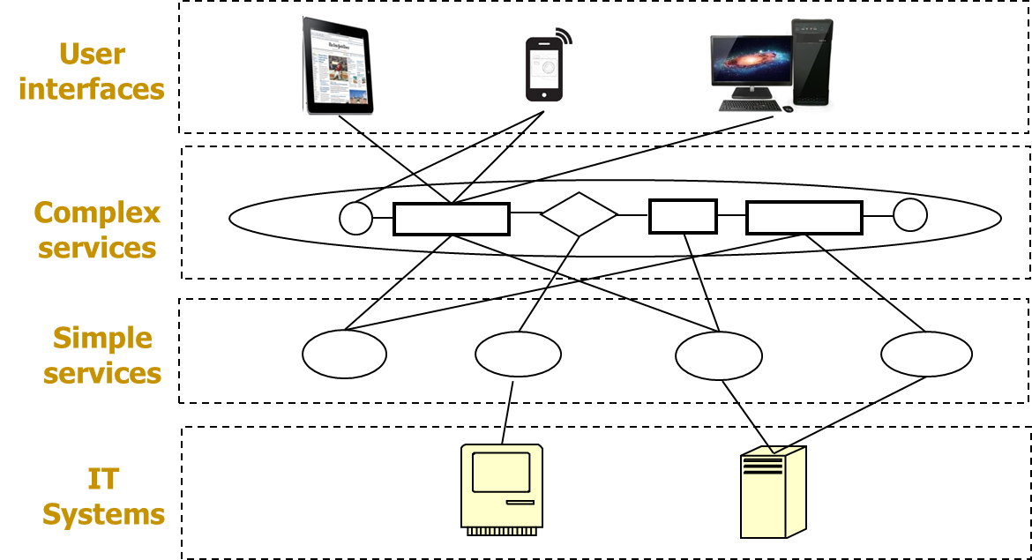
Service-Oriented Architecture
Consider turning all IT systems into services
Each service can be small, simple, or large, complex
Develop and maintain enterprise solutions as assemblies of loosely-coupled services
Manage assemblies at various layers of different functionality and/or complexity. Sample layers:
Notes:
The functionality from lower layers can be reused by higher layers, saving the efforts needed to develop the high layers.
Each unit in each layer may be developed and maintained by different teams.

Slide 5
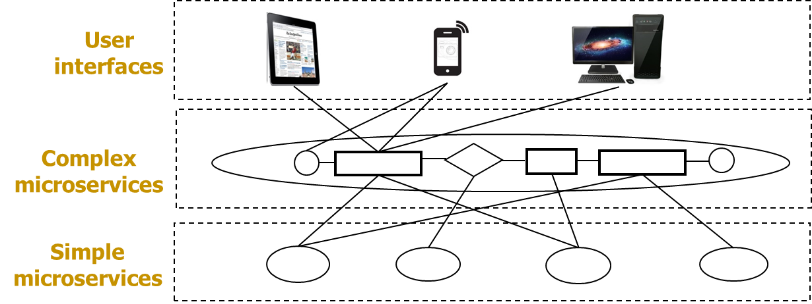
Microservices and MSA Revisit
A microservice may be defined as:
A service that can be independently developed and deployed and provides one or a few functionalities needed to support business requirements
Develop and maintain enterprise solutions as assemblies of loosely-coupled microservices
Provide all functionalities needed as microservices
Each microservice is relative small, simple
Sample SOA layers with microservices:
Notes:
A service can be considered as a microservice if the application implementing the functionality of the service is NOT monolithic and can be easily deployed and scaled.

Slide 6
Types of (Micro)Services
Atomic/Simple (Micro)Service
A (micro)service that provides functionality related to one kind of entity of a business concern (e.g., Book, Customer, etc.)
The operations provided by the (micro)service can be CRUD
The implementation details of the (micro)service within its interface is independent of others within an enterprise context
It may be developed with any tool in any language on any OS of choice
An atomic microservice is self-contained, without depending on a monolith or other (micro)services
An atomic service may depend on others, as a “wrapper” to expose some functionality in a monolith or external APIs
Composite/Complex (Micro)Service
A (micro)service that provides functionality related to more than one entity (e.g., Place an order, Process a shipping record, Restock inventory, etc.)
The functionality provided by it consists of a set/sequence of activities (including direct communication with others) for a business process, which may depend on others
It may be developed with any tool in any language on any OS of choice
A composite microservice may depend on other (micro)services, but should not directly depend on a monolith
A composite service may depend on a monolith and other (micro)services, but not recommended
Notes:
"Atomic"/Simple means it is a single irreducible unit and is not beneficial (for an enterprise context) to be further broken down into smaller units.
In the context of (micro)service development, it means:
It may not invoke other (micro)services via HTTP, as invoking others would mean it depends on others' URLs;
It may not directly communicate to other (micro)services;
it may still send reply messages if requested;
it may still send data out (e.g., publishing a message), but should not directly contain the receivers' information inside itself;
"Composite"/Complex means it is comprised of functionality from other components. The composition of (micro)services is done via IPC, not via normal function calls.
In the context of (micro)service development, it means:
It invokes other (micro)services via HTTP, or
It directly communicates to others, e.g., by sending a request to a particular receiver and waiting for a reply
A composite (micro)service needs to know the interfaces (e.g., URLs, routing keys, data formats) of all others it communicates with.
A composite microservice shouldn't directly communicate to a monolith, so that it can be independently deployable and scalable
A composite service that directly uses functionality of a monolith and other (micro)serivces is not recommended (although technically can be done), as that increases coupling between the service and the monolith.
A better way is to expose monolith's functionality as a set of atomic services, then build a composite microservice that provides the monolith's functionality via using those atomic services and other (micro)services. See sample layers below and the case studies.

Slide 7
Example: User Scenario Diagram – Browse books
Book
1. Get all books
HTTP
2. Return all available books
Amazing Bookstore UI
Browse available books
Legend
Micro-service
External service
Notes:
Communications between bookstore UIs and the microservices, e.g., Book
this Book is atomic

Slide 8


Example: User Scenario Diagram – Place an order: Implementation with HTTP and AMQP
5. Send the newly created order
{ order }
Shipping Record
Order
3. Send the order information
{cart items}
4. Return the newly created order
{ order }
HTTP
6. Return the created shipping record or error
HTTP
AMQP
Place an Order
Activity Log
2. Send the order activity for recording
1. Send the order information
{cart items}
7. Return the created order and shipping record and/or error
HTTP
AMQP
If error from any service, activate the error handler
Error
Amazing Bookstore UI
Place an order
Producer/sender of request data
Consumer/receiver of request data

Slide 9
Microservice Attributes
Attribute | Atomic/Simple | Composite/Complex
Independently Deployable | Yes | Yes
Independently Scalable | Yes | Yes
Any Programming Language | Yes | Yes
Encapsulates… | … a single “atomic” entity (e.g., Customer, Product) | … a single process. It often orchestrates or aggregates other atomic/composite (micro)services.
Naming Convention | Noun E.g. book, order, shipping_record | Verb E.g. Place order, Process shipping
Can invoke other services | Never | Yes, that is its main purpose
Data ownership | Typically has exclusive ownership of the database tables for its data entities | Typically does not own data, but requests the data via the APIs of other services
Notes:
A service (not a microservice) may not be independently deployable/scalable when it depends on a monolith.
A business process can be "straight-through" (i.e., can be fully automatable to run through multiple steps quickly without obvious pauses in the middle), or long-running (i.e.,, can take long time to run since it involves human interactions in the middle of the process and need to pause in the middle to wait for human inputs or data that may only come at uncertain time).
E.g.,
"Browse books" is a straight-through process; "Place an Order" in our scenario is straight-through (without considering the error handling, actual shipping, etc.);
"Process a Shipping Record" can be long-running when we consider shipping/delivery as part of the process, since shipping/delivery often involves human operations and takes relatively long time to complete.

Slide 10
Activity
Suppose a retail organization has three composite microservices (orange) that consist of the atomic services (blue) in each row. The atomic services (not microservices) expose functionalities from the IT systems/applications (yellow). The applications may be monolithic.
Reorganise the (micro)services and applications into 3 layers shown in the template on the next slide and connect them based on possible interaction/communication relations.
Inquiry
Balance
Get Cust
Acc Num
Get
Account
Balance
Manage
Order
Get Cust
Acc Num
Get
Account
Balance
Check
Inventory
Get Cust
Address
Update
Inventory
Update
Order
Update
Account
Inquire
Order
Get Cust
Acc Num
Get
Orders
Inventory
System
Order Mgmt
System
CRM
System
Accounting
System

Slide 11
Sample SOA Layers for the Activity
Inquire
Order
Composite Microservices
Get
Orders
Get Cust
Acc Num
Atomic Services
Inventory
System
Order Mgmt
System
CRM
System
Accounting
System
IT Systems
Notes:
The IT Systems/applications act as data sources for the atomic services. They may be monoliths without service interfaces (although they may provide APIs e.g., functions that can be invoked by other systems/services)
The atomic services provide service interfaces for the monoliths, by accepting requests from other microservices or UIs, transforming data, and invoking some functionalities of the IT Systems/applications (often by invoking some of their APIs).
The process to provide a standard service interface for some functionalities of an IT system is called to expose the functionalities of a system as a service. Although this service is "atomic", it is usually NOT a microservice because it depends on the IT system which may be a monolith, and it's not easy to just deploy the service itself without deploying the IT system together.

Slide 12


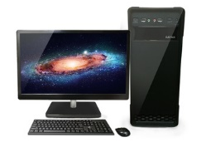
Sample SOA Layers & Supporting Infrastructures for an Enterprise
API Gateway
User Interface Layer
Business Process Management
Composite Services Layer
(long-running processes)
Interactive
Auto
Auto
Enterprise Service Bus
Composite Microservices Layer
(straight-through processes)
Composite
Composite
Composite
Atomic Microservices Layer
Atomic
Atomic
Atomic Services Layer (Expose/“wrap” the functionality of IT Systems)
Message Broker
Atomic
Atomic
Atomic
Atomic
…
IT Systems Layer
External Services
Notes:
The layers may differ from one enterprise to another.
The functionality from lower layers can be reused by higher layers, saving the efforts needed to develop the high layers.
It'd be easier to make changes to individual components in each layer due to reduced coupling.
A composite (micro)service can directly communicate with another composite (micro)service and atomic (micro)services, but not to IT systems/monoliths.
All the UIs may access services via a gateway layer; we used API gateway in our lab for managing accesses to REST microservices.
Beyond the course scope:
Composite (micro)services can be long-running processes. When there are many processes running at the same time, it'd be easier to manage all the processes using a dedicated Business Process Management Engine (BPME, or just BPE) as part of the large-scale enterprise solution.
Internally, there can be additional infrastructural layers (e.g., ESB) to help manage the services and their communications.

Slide 13
Sample SOA Layers & Supporting Infrastructures for an Enterprise
User Interface Layer
Provides the interfaces for interactive activities with users
Can trigger a business process, which may trigger composite and/or atomic (micro)services
Do NOT invoke monoliths directly; only use monoliths indirectly via other (micro)services
Business Process Layer
A business process can be long-running involving user interactions (e.g., Loan Approval that requires a human approval) or straight-through (e.g., one-click ordering)
A business process can be implemented as a (micro)service, usually composite
Composite (Micro)Services Layer(s)
Can directly communicate to other (micro)services in the same or lower layers, but not to (micro)services in the higher layers
Atomic (Micro)Services Layer(s)
An atomic microservice can be independently developed, deployable, and scalable
An atomic service may depend on a monolithic IT system or some external services
Do NOT directly communicate to other atomic (micro)services
IT Systems Layer
Applications (COTS, Custom or Legacy) that provide one or many functionalities
Do NOT directly communicate to other applications
External Services Layer
External services from third-parties, usually beyond the control of the enterprise; may or may not be microservices
May be directly used by components other layers
API Gateways
Manage accesses to (micro)services, usually for external service consumers
Business Process Management Software Suites (BPMS)
Manage business processes (including design, modelling, analysis, implementation, execution, monitoring, optimization, etc.)
Enterprise Service Buses
Manage accesses to (micro)services, usually for internal uses in an enterprise
Communication Technologies
Message brokers
HTTP servers
Storage Servers
DBMS, SharePoint, Drive, …

Slide 14
Sample Benefits of Microservices and SOA Layers
Enforce a high degree of modularity and help to manage complexity in large enterprise solutions
Atomic “Wrapper” services are less modular than atomic microservices due to their dependency on the underlying (monolithic) applications
Microservices are loosely coupled from each other
Independently developed, deployable, scalable
(Micro)services interact with each other through standards-based interfaces
Independent of programming languages or platforms
Common errors (e.g., timeout, network interruption, wrong data format, etc.) may be handled in a standard way.
Easier to reuse a (micro)service than a monolith
Implementing a business process is like to assemble a composite microservice that reuses other (micro)services.
Easier to change individual (micro)services than to change monoliths
Easier to support continuous integration and deployment (CI/CD) for changing business requirements

